Slide 1


What has been the impact from air pollution on global health problems from 1990 to present?
Manunpat Sirijaturaporn, Derek Greiner, and Arturo García Luna Beltrán
MSc Management – Data Science for Business Analytics
Group 8
December 15, 2021

Slide 2




Introduction of the research analysis
Brainstorming
Research Objective
Main Research Questions
Test Results
Notes:
Hey guys blablabla.
We chose a subject related to environment because it is a topic that affect us and that we will have to deal with as a society in the near future.
After some research and articles, we found, we decided to pick health and air pollution as the main topics as it is something that affects everyone in the world and will probably stay forever.
First, we will do some descriptive statistics by:
Comparing the evolution of the global mortality and the global air pollution
Analyzing Air pollution with seasonal changes
These will give us a basic understanding of some trends that could help us with further questions.
The 2nd part will focus on inferential statistics where we will do:
Regression analysis to understand which economical factors are more correlated to air pollution. We will also compare results of Landlocked countries vs none landlocked countries
Regression analysis of which pollutant has the higher impact on mortality.
This will hopefully help us understand which are the main causes of Air pollution economic wise as well as which pollutant in the air is the deadliest.

Slide 3
Descriptive Statistics
1.1 How have the air pollution levels changed from 1990 to 2019?
How has mortality rate changed?
Air Pollution
Air pollution is rather stable / slightly decreasing
Only one pollutant (PM2.5) is considered
PM2.5 mainly comes from households, particularly by wood heating
Mortality
Mortality is increasing considerably
Some diseases take years to develop
This trend makes sense considering current environmental situation
Notes:
Air pollution is slightly decreasing over the years, which goes against current trends, but it is explained by the fact that we only have data for one pollutant (PM2.5).
This pollutant comes mainly from households that are using wood heating. This could explain the slight decrease, as developed / developing countries are moving away from wood heating for other solutions
Mortality is greatly increasing, which goes according to global pollution trend. Keep in mind that some diseases take years to appear (like cancer), so the air pollution data from 2017 could only affect mortality in 2040 for example.
→ If we considered more pollutant, we think we would have seen an upward trend like the mortality one.

Slide 4
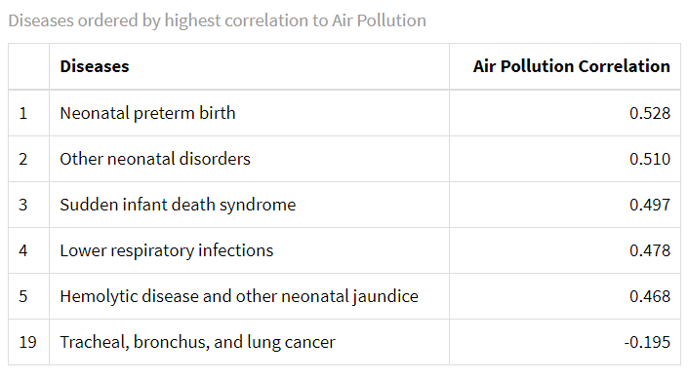
Descriptive Statistics
1.2 What are the diseases with a higher correlation with air pollution?
Most correlated diseases remained stable or are decreasing
Diseases that grew the most are the one with a negative correlation
Diseases are never related to only one factor
→ PM2.5 is an important factor on neonatal diseases, however further tests with other pollutant would be necessary to see if it is the most important factor
Notes:
The most correlated diseases are the one linked to infants or newborn (Air pollution can affect pregnancy and newborn that are more fragile).
We observed that the most correlated, follow the same trend as Air pollution (decrease / slight increase)
However, diseases are never only due to one factor, so it is hard to draw conclusions. We especially see that with diseases like cancers or diabetes that have a negative correlation -> they are due to so many factors, some even unknown to man, that only one pollutant cannot explain them at all.
→ With some research we were able to confirm that PM2.5 is an important factor to neonatal diseases, but we would need to do regression with other pollutant to confirm if it is the major one or not.

Slide 5
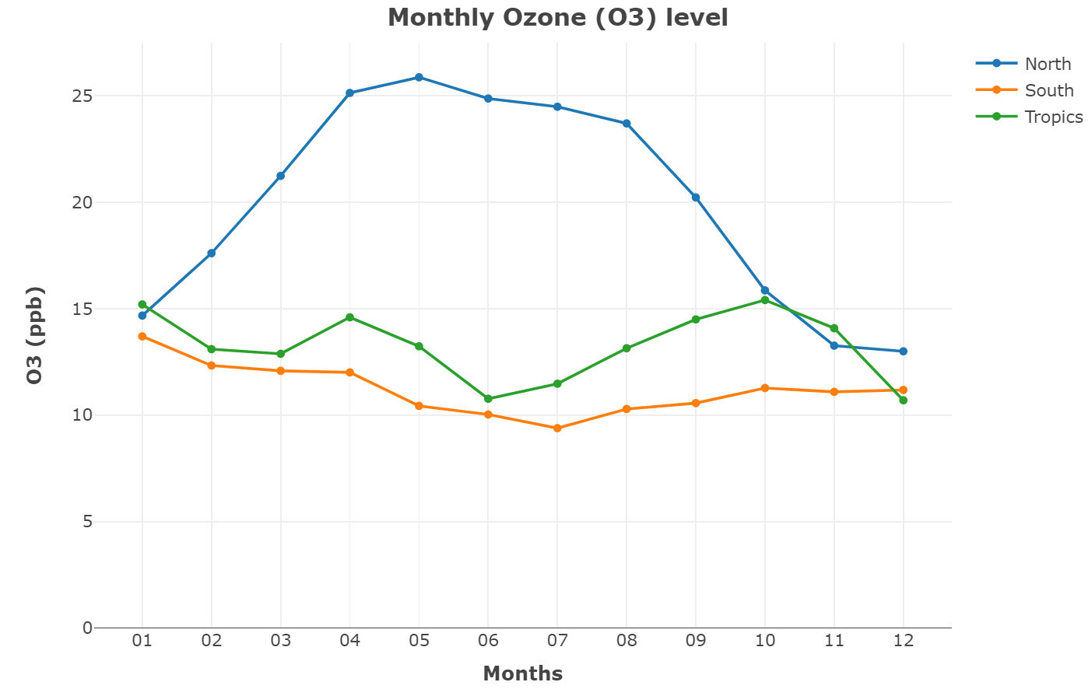
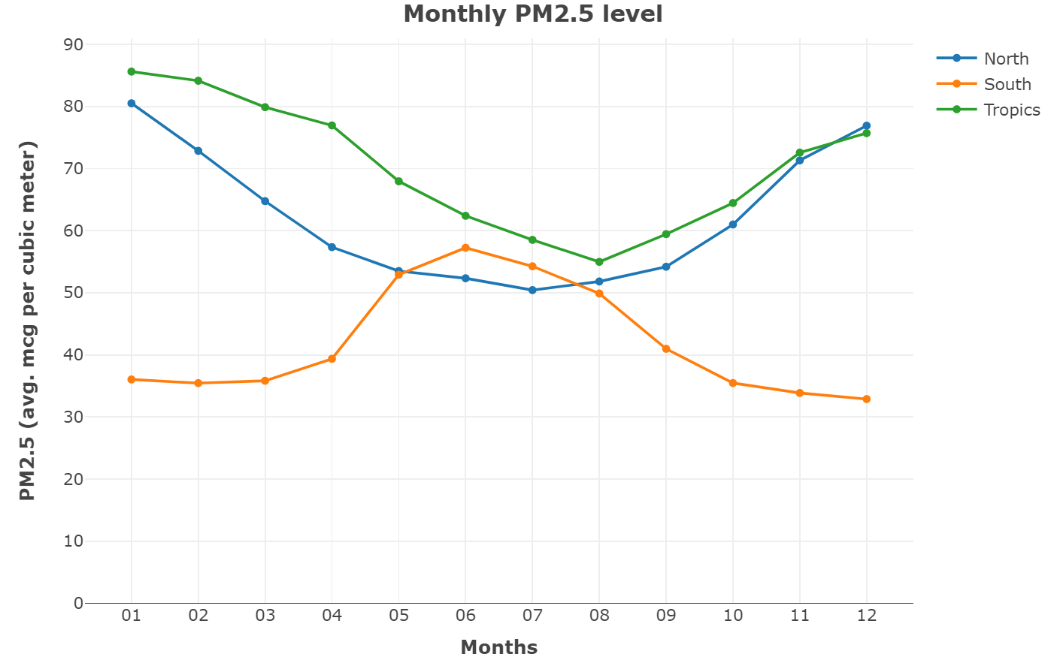
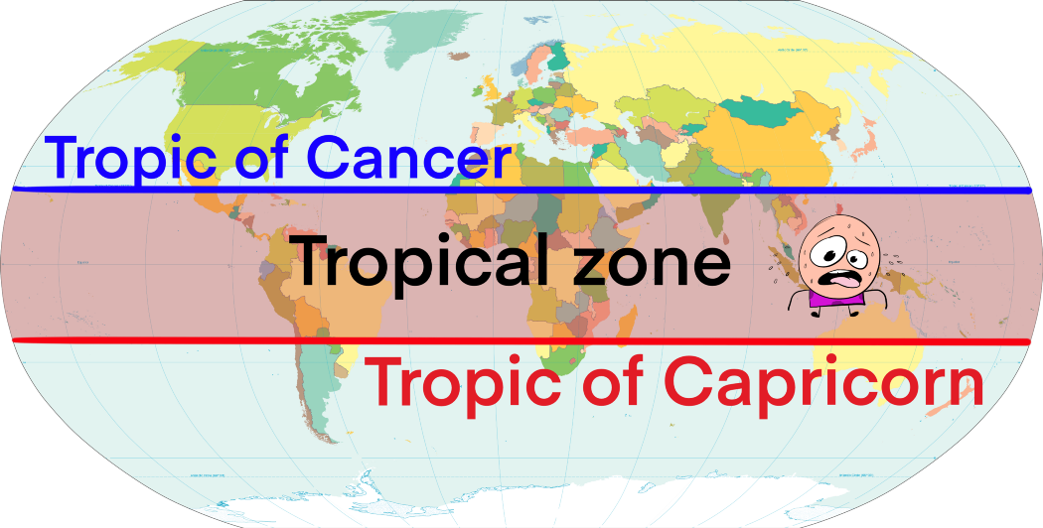
Descriptive Statistics
1.3 Does air pollution change with the seasons?
Source of world map: https://medium.com/i-wanna-know/what-exactly-are-the-tropics-c6c2e68f2dbc
Notes:
In this section, we would like to study seasonal pattern of air pollution and we concluded that air pollution changes with seasons. We will present the results from 2 air pollutants which are PM2.5 and ozone due to the interesting pattern of them.
First of all, we divide countries into 3 groups due to seasonal differences.
PM2.5 level reached to the peak during wintertime. However, seasons in the south group are opposite to those in the north group which is the reason why we see blue line and orange line are up side down. It is because cold air is denser and air pollution is trapped in the cold air. For the tropical countries, they have narrow temperature difference between season so it’s more difficult to observe the trend.
However, O3 level had an opposite trend because it’s caused by chemical reactions between other pollutants and sunlight so its level tends to increase in summer for the north and south groups. For the tropics group, the level fluctuate due to the quite stable temperature and sunlight all around the year. Arturo is gonna take over Inferential Statistics

Slide 6
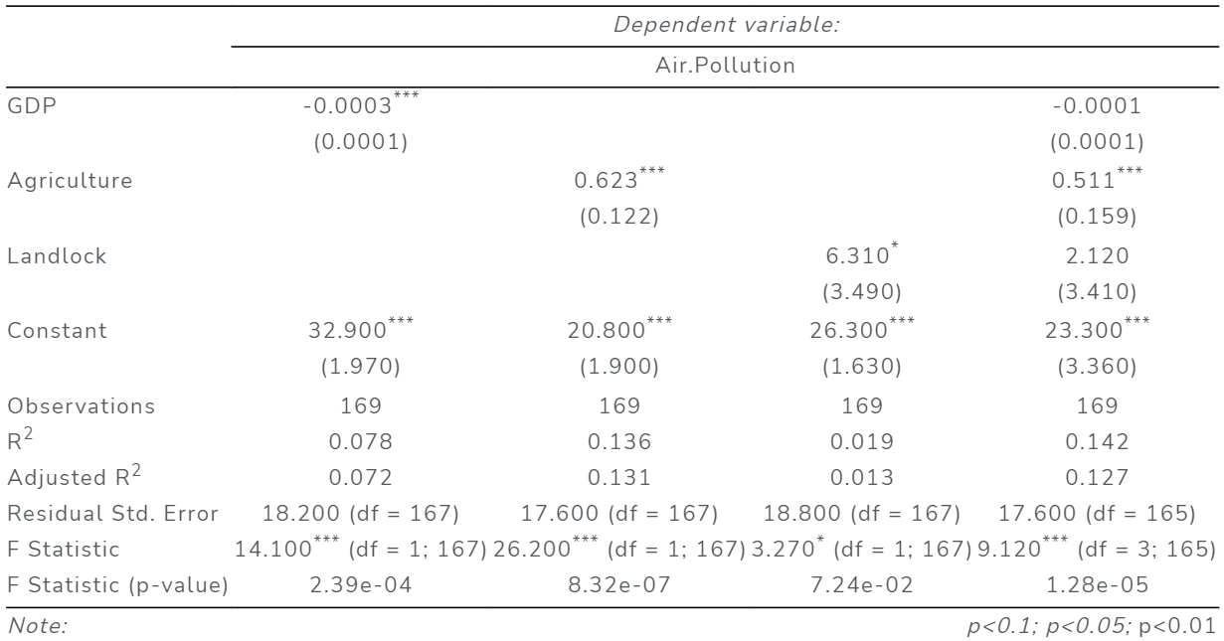
2.1 What are the factors that impact air pollution the most(GDP and Agriculture)? 2.2 Are landlocked countries more polluted?
Inferential Statistics
Notes:
Before looking at the impact of air pollution on diseases, we measured the factors that impact air pollution the most and the effect of being landlocked with OLS regressions. We see that on their own, each independent value such as GDP, Agriculture and being Landlocked are significant to explain air pollution as shown by the F-Statistics.
When running the model with all independent variable, we identified that GDP as well as being a Landlocked country were no longer significant, yet Agriculture kept a high significance. It is worth noting that the model with only Agriculture was the one with the highest predictive power, and by looking the Adjusted R-squared we can say that it can explain 13% of the variation of air pollution.

Slide 7
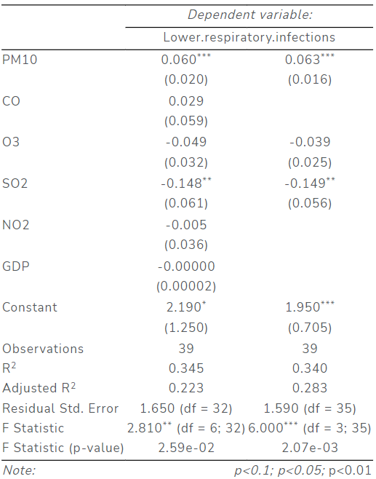
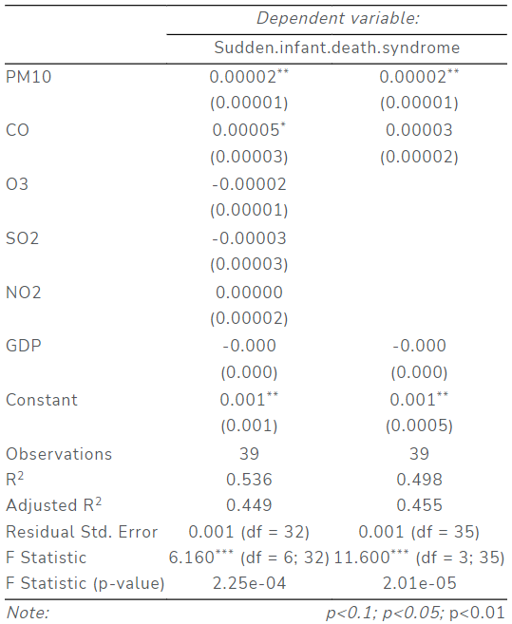
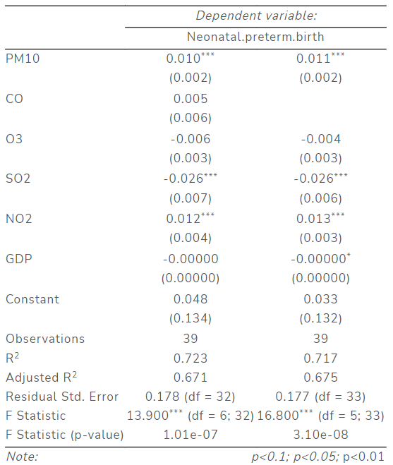
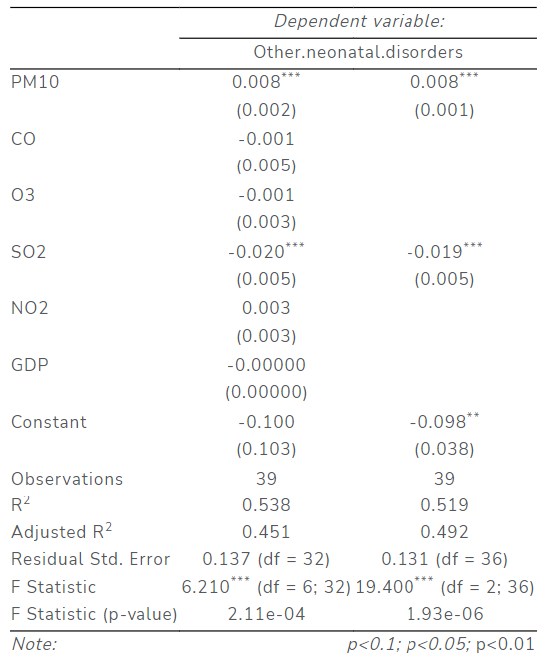
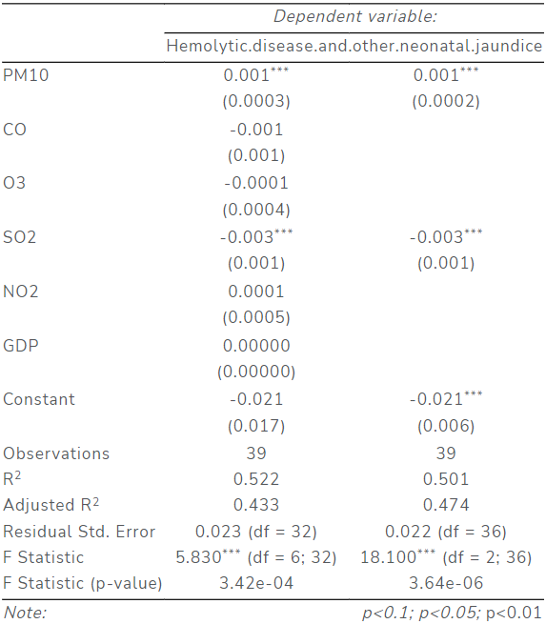
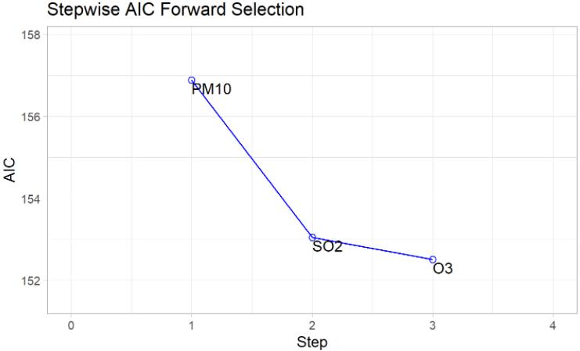
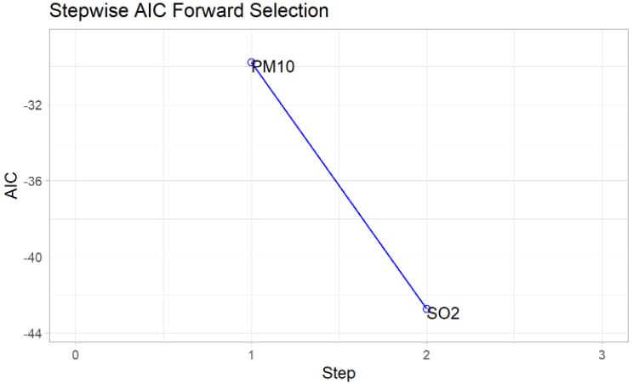
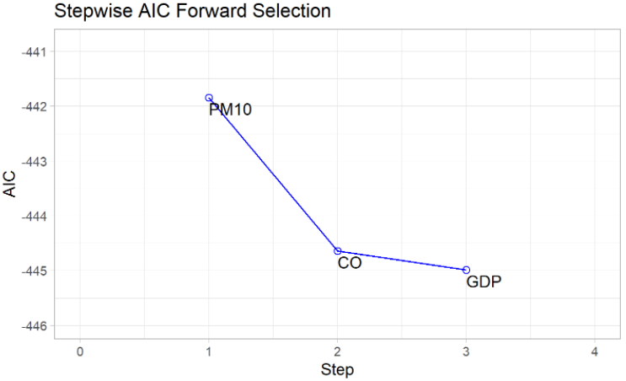
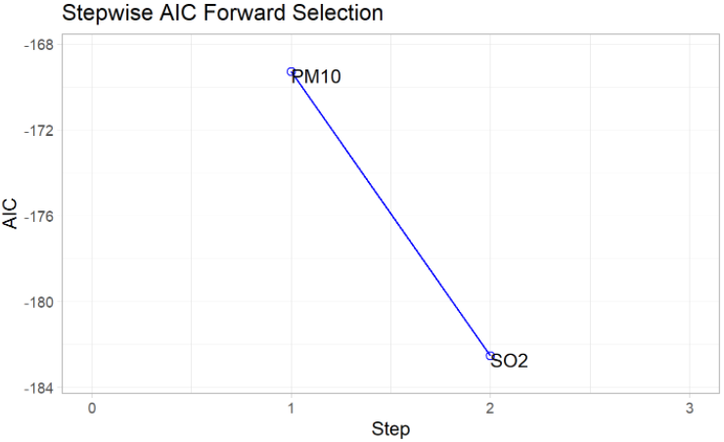
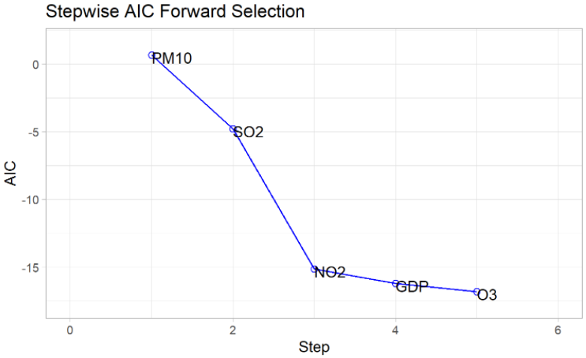
Inferential Statistics
2.3 What has been the effect of air pollution on some health diseases mortality?
Notes:
We then assessed the effect of air pollution on the top 5 diseases’ mortality that we found had the highest correlation with air pollution by using five different Stepwise AIC Forward Selection regressions. For all 5 diseases, the model selected by the method did not include all air pollutants. Also, in all 5, the final model was better than the base model which included all air pollutants, with respect to both the Adjusted R-squared and the F-statistics. We can also note that PM10 was the most significant variable to explain all 5 diseases’ mortality.
As a result of the F-Statistics of the five final models and the beta coefficients, we can conclude that an increase of 1 unit in PM10 will have an effect on the mortality rate of these diseases from 2 to 14%.

Slide 8
Limitations and Future work
Lack of global air pollution data before 1990
Missing factors
Limitations
Focusing on regional scale
Adding more factors such as transportation, mining and meteorological condition
Impact of Covid-19 lockdown on air pollution level
Future Work
Notes:
This study made us realize that assessing the impact of air pollution on health problems is way harder than it seems. The data set for air pollution has relatively short history because some health problems take years to develop, this make it difficult to analyse correlations between these data overtime. Also, in order to perform a comprehensive air pollution analysis on a global scale, we believe that we need to incorporate more factors, besides Agriculture, GDP and landlocked, in our model.
For the future work, we should focus our analysis on a regional scale because different areas have different emission sources and regulations. Also, we should incorporate more data in our research to understand about the sources of air pollution; for example, transportation, mining activity and meteorological conditions such as wind speed and humidity. Moreover, man-made activities and air pollution is an interesting topic. Data during the Covid-19 lockdown when the human activities was suspended could provide more insight about this topic. Thank you for your attention.

